Slide 1
CSAP Chapter 1
A Student Collaborative Presentation

Slide 2
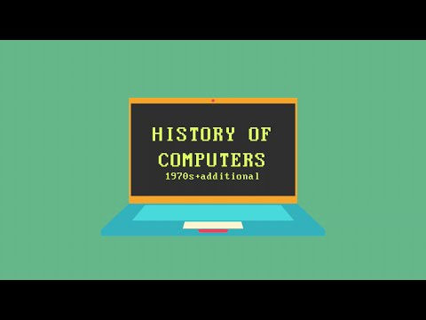
1.1 History of Computers
ENIAC (the Electronic Numerical Integrator and Computer), the first digital computer, took up a whole room, but as years passed by people were able to build more complex machines by using less space.
Now most households have computers or other electronic devices that connect to the internet via wi-fi, giving users a lot of comfort. Computing has become ubiquitous as they are in use everywhere.
In the early 1950’s, IBM sold its first business computer.

Slide 3
1.2 Computer Hardware- Surya Neelee and Alok Chatterjee
Hardware consists of physical devices that you see on your desktop
Software= consists of the programs that give the hardware useful functionality.
bit= binary digit, is the smallest unit of information processed by a computer and consists of a single 0 or 1
byte= consists of eight adjacent bits
The capacity of computer memory and storage devices is usually expressed in bytes.
User interface= supports moment to moment communication between user and computer
Auxiliary input/output(I/O)= devices such as printers and scanners
Network connection= connect to internet and rest of the world
modem(modulator-demodulator)= is a device or program that enables a computer to transmit data over
Auxiliary storage, or secondary memory, devices are used for long term storage of programs and data.
RAM, or internal memory, is used for momentary storage of programs and data.
Primary memory(RAM) or random access memory is a high speed internal memory.
Flash memory sticks with the capacity of multiple gigabytes and are the most convenient storage devices.

Slide 4
Exercises 1.2
One byte consists of 8 adjacent bits, therefore a byte is 8 times bigger than a bit.
Two examples of input devices are the mouse and the keyboard. Output devices include the monitor and the speakers.
The purpose of auxiliary storage is to store the computer's operating system, applications, and documents.
RAM, which stands for Random Access Memory, is the is responsible for the momentary storage of data and programs.
Hardware is the physical part of the computer, like the chassis and the circuitry, while the software is the OS and all of the programs that the computer has.

Slide 5
1.2 Central Processing Unit - Khush Tated and Hardik Veguru
Does all the work of the computer.
Can do arithmetic, along with comparison I/O operations. The complexity comes from how the programs can direct the CPU
Basic tasks might be easy, but hardware is complex. The complexity allows for the fast execution of tasks.
Moore’s Law: Doubling speed of computers every two years, by increasing transistors on circuits.
The applications using the CPU will determine its efficiency and quality
Transistor: Basic building block of the CPU and RAM. When on, it conducts electricity. When off, it doesn’t. Computer programs and data are stored in ons and offs.
Sequence of events that occur when program is executed:
The program and data are loaded from auxiliary storage in different parts of the RAM
CPU copies program’s first instruction from RAM in a decoding point
CPU decodes the instruction and sends it to the Arithmetic and Logic Unit(ALU)
The CPU determines the location of the next instruction and repeats the process of copying, decoding, and executing instructions
After program is done executing, the data portion of the RAM contains the results of the computation that the program performed
Intel and AMD are some famous examples of CPUs

Slide 6
1.2 Computer Software
System Software
Allows users to transfer information to the computer
The operating system can run multiple programs concurrently
Communications software is used for connecting to the internet and other computers
Compilers translate user programs into executable form
The user interface subsystem is responsible for the look and feel of the computer such as overlapping windows
Application Software
Allows users to accomplish specialize tasks
Ex: Word Processors, Spreadsheets, Database Systems, Multimedia software,.

Slide 7
1.3 Binary Representation of Integers and
Floating-Point Numbers
Numbers with a fractional part are called floating-point numbers.
One way to represent them as binary is to use the mantissa/exponent notation
Where the number is rewritten as a value between 0 and 1, times a power of 10
In this way we can represent any floating-point number by two separate sequences of bits, with one sequence for the mantissa and the other for the exponent.
Many computers follow the slightly different IEEE (Institute of Electrical and Electronics Engineers) standard
The mantissa contains one digit before the decimal or binary point.
In binary, the mantissa leading 1 is then suppressed. Originally, this was a 7-bit code, but it has been extended in various ways to 8 bits.

Slide 8
1.3 Sound, Images, Video, Program
Instructions, Computer Memory
Sound:
Is analog, meaning information has a continuous range of infinitely many values.
Higher the wave, the higher the volume
Closer cycles are, the higher the sound pitch
Memory storage requirements are much greater than that of storing text
Images:
Once again analog info with infinite set of color and intensity values.
The more pixels, the more clarity in the image
True color scheme - RGB (based on human visibility of the colors red, green, and blue)
Sampling device (such as a camera) selects a value of color and intensity closest to the color of the image
Video:
Consists of a soundtrack and set of images called frames
Frames are snapshots recorded in sequence at a given time interval
Major problem is storing video data… Large amounts of uncompressed data often can’t fit on a DVD, so compression application such as MPEG were created

Slide 9
1.3 Sound, Images, Video, Program
Instructions, Computer Memory Cont.
Computer Memory:
Essentially a gigantic sequence of bytes
Bytes location in memory is called an address
Addresses are numbered based on number of bytes in memory in a computer
A group of bytes can represent a number, a string, a picture, a chuck of sound, or a program instruction.
Program Instructions:
Represented as a sequence of bits in RAM
For example a computer may store two data values located in RAM and store their sum in a third location
The first group of 8 bits represents the ADD command
Called Operation Code or opcode

Slide 10
Exercise 1.3 - Pranavi Parsi and Calvin Li
Translate 11100011 base 2 to a base 10 number
2^7+2^6+2^5+2^1+2^0=128+64+32+2+1=227 base 10
Translate 45B base 16 to a base 10 number
4(16^2)+5(16)+11=1115 base 10
What is the difference between Unicode and ASCII?
Each character in Unicode is represented by a pattern of 16 bits/2 bytes. Each character in ASCII is represented by a pattern of 8 bits/1 byte.
Assume 4 bits are used to represent the intensities of red, green, and blue. How many total colors are possible in this scheme?
2^4=16 total colors
An old fashioned computer has just 16 bits available to represent an address of a memory location. How many total memory locations can be addresses in this machine?
Since the computer has just 16 bits available to represent an address, there are 65,536 memory locations which can be addressed in this machine.

Slide 11

Computer Ethics according to
ACM (pg 18, 27) - Girish and Sathvik
ACM - Association for Computing Machinery - supports research, provides standards
Contribute to society
Be honest
Be fair
Respect privacy
Professional responsibilities include:
Striving to find the best way to solve problems
Accept criticism and build on it
Honor contracts
Improve public understanding of computing
Copyright, Intellectual Property, and Digital Information
rise of digital info and its transmission → authors and publishers seek to protect their IP from profiteers, while users and computer professionals favor the fair use of information and its free access.

Slide 12
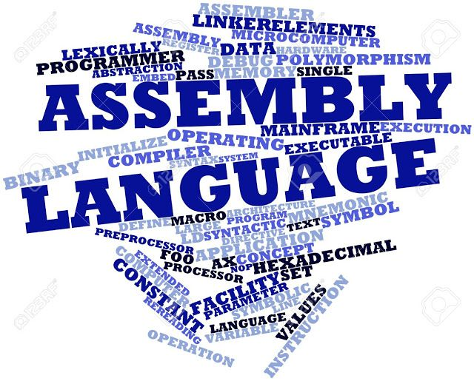
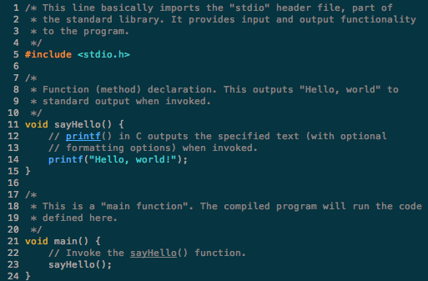
1.4 Programming Languages - Suhayb & Akshay
Programming can be divided into three categories in history
Generation 1 - Machine Languages ( 1940s-1950s)
Computers were expensive and Programs were short
Everything was coded in machine language whose only symbols were the binary digits 0 and 1
People had to enter data directly into the RAM in the form of zeroes and ones
Coding was tedious,error prone, and difficult to modify
Sharing was hard, as it was nearly impossible to decipher another person’s program
Programs weren’t portable, because each machine had it’s own unique language
Generation 2 - Assembly Languages (1950s-Present)
Assembly language uses mnemonic devices to represent instruction and data
Each assembly language instruction corresponds exactly to one machine language construction
It was more programmer friendly but still tedious to use and difficult to modify
Rarely used by programmers except when memory or processing speeds are at premium
Generation 3 - High-Level Languages (1950s-Present)
Early Examples: Cobal, Fortran
Recent, Modern Examples: Java, Python, C++
Meant to be human friendly, as they are easy to write, read, and understand
Translated to Machine Language through a compiler
Portable, but with exception of Java, must be compiled for each different type of computer

Slide 13
Exercise 1.4 - Suhayb & Akshay
1. Two difficulties of programming with machine language:
Difficult to modify programs
One person can’t decipher another’s program
2. Two features of Assembly Language:
Uses mnemonic symbols to represent instructions and data
Numbers and results are stored in a memory location named the mnemonic
3. A loader is what loads and runs a machine language program
4. One difference between a High-Level Language and Assembly Language is that a High-Level Language is easily portable, but assembly languages aren’t any more portable than machine language.

Slide 14
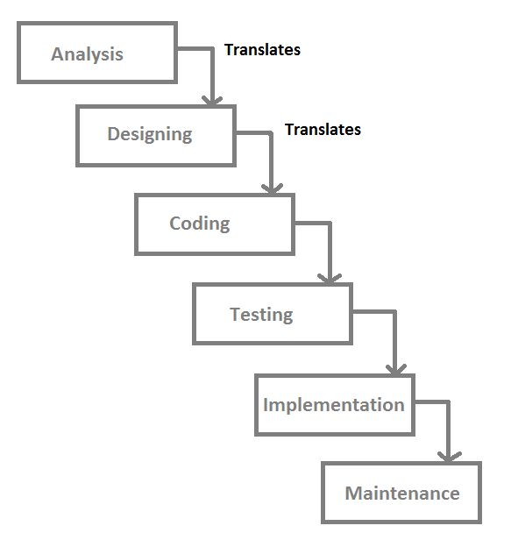
1.5 The Software Development Process- Somya Jain and Sravani Boppana
Software development: the process of development, maintenance and demise of a software system. Phases include analysis, design, coding, testing/verification, maintenance, and obsolescence
Waterfall model: a series of steps in which a software system trickles down from analysis to design to implementation→ phases include:
Customer request: programmers receive a broad statement of a problem that is potentially amenable to a computerized solution
Analysis: programmers determine what the program will do
Design: programmers determine how the program will do its task
Implementation: programmers will write the program(coding phase)
Integration: different parts are brought together into a smoothly functioning whole
Maintenance: during the long life span of a program, requirements change and minor or major modifications must be made.

Slide 15
Exercise 1.5- Gayatri & Swasti
Analysis— The programmers determine what the program will do. This is sometimes viewed as a process of clarifying the specifications for the problem.
Design—The programmers determine how the program will do its task.
2) The maintenance phase is the most expensive aspect of software development.
3) A mistake detected in the verification or testing in one phase often requires the developer to back up and redo some of the work in the previous phase.
Modifications made during maintenance also require backing up to earlier phases.
4) Analysis phase is the least expensive for the detection and correction of errors.

Slide 16
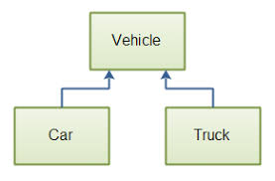
1.6 Basic Concepts of OOP - Katherine and Nikha
Was created to address the flaws of procedural programming (associated with C and Pascal)
Uses objects and interaction between objects
Also includes class, inheritance, polymorphism (more than one object responds to a mutual message, but have different reactions)
Steps to writing a program: 1. Planning 2. Execution 3. Outcome
Parts:
Classes
Instance variable
Methods (constructor included)
Combined with encapsulation
Inheritance: creates sub-divisions of a class
Abstraction: objects provide access to services but not their data resources
Example of inheritance
Notes:
Whats up with this whack font bruh -_-

Slide 17
Exercise 1.6 - Tej and Harsh
Q: In what way is programming like planning the construction of a house? A: You need to plan out what you are going to do (planning), assign responsibilities (execution), and determine how many of each you need (outcome).
Q: An object-oriented program is a set of objects that interact by sending messages to each other. Explain. A: This means that when an object receives a message, it refers to its class to find a corresponding rule or method to execute.
Q: What is a class, and how does it relate to objects in an object-oriented program? A: A class is nothing but a blueprint for creating different objects. The class defines the object’s properties.
Q: Explain the concept of inheritance with an example. A: Inheritance is the process where one class acquires the properties of another. An example would be a subclass.
Q: Explain the concept of information hiding with an example. A: Information hiding is the principle of providing access to services but not to data resources. If object A needs a service If an object A needs a service that it cannot provide for then A requests the service from well-known provider B. However, A knows nothing of B’s data resources and never asks for access to them.

